Slide 1
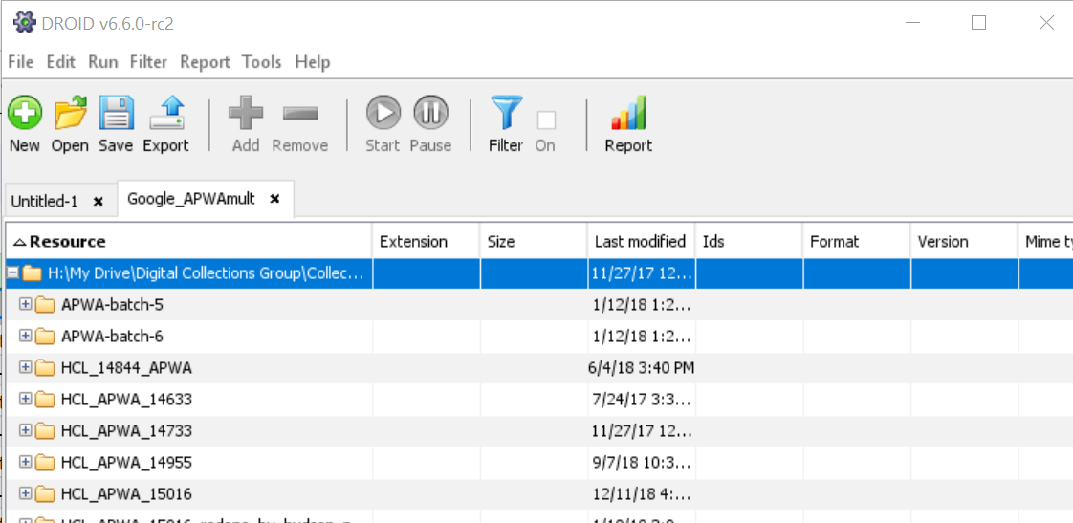
Start at the Beginning: Workflows for Inventorying Digital Collections
Kim Hoffman, Digital Curation & Preservation Librarian
Hamilton College
Abstract
Step 3: Develop a Process and Iterate
My Phase 2: Item-Level Inventory
While establishing a digital preservation program may seem daunting, it always begins with a first step. Often, that step involves information gathering and inventory. It is critical to first understand the nature of a digital collection before it is possible to take steps to preserve it. After stepping into a newly created Digital Curation & Preservation role, my first priority was to develop an inventory process that would allow me to understand and document the scope of our digital assets. This poster describes the steps I took to develop a digital collections inventory procedure, from identifying and gathering necessary information, to testing tools, to documenting the process.
Started with a template from the Canadian Heritage Information Network (CHIN) for ideas, but I knew something simpler would be a better fit for my needs.
Addressed questions as they came up through iterative improvements:
Do I want a file-level or folder-level inventory?
How can I automate these steps? (Manual is more error prone)
What tools can help me with this?
Can I speed this process up?
Second, developed a procedure for generating checksums that also became a file-level inventory procedure.
Tools used: DROID, Excel, Google sheets
Pros:
Checksums aid in de-duping files and verifying fixity and authenticity long-term
Captures information about individual files
DROID offers additional reporting such as file size by last year modified
Cons:
Can be slow and finicky
Harder to see big picture at a glance
Step 1: Establish the Goal(s)
Step 4: Document the Process
DROID and Partial Item-level Inventory Example:
In our case, the goal was to get a better understanding of the amount of storage space we were currently using and how quickly we were filling it
This will allow us to define our requirements when we begin exploring digital preservation systems, likely next year
Complicated by haphazard digital curation over time; many duplicate or obsolete files
Secondary goal: Orient myself as a new steward of the content
Mostly digitized content and department content related to past and current digital asset management systems
Learn the locations where content might be stored
Learn where new content is coming from
Adopt the mindset that each iteration is not done until your documentation is updated. Advocate for documentation as an equally important part of the process. Also include:
Known issues
Ideas or wish list for future improvements
Last modified date for your documentation
My Phase 1: Directory-Level Inventory
First developed a directory-level inventory procedure. This was fairly low-tech and easy to start manually before adding in light automation.
Tools used: Directory tree script (found example online), Excel, Google sheets
Pros:
Allows me to quickly see where we keep files related to particular collections
Captures number of files in directory, creation date, last mod date
Runs relatively quickly
Cons:
Doesn’t generate or record checksums
Doesn’t capture individual file information
Step 2: Identify Requirements
In order to support my goals, my inventory process had to meet at least these requirements:
Generate checksums in order to identify duplicate content
Capture file sizes and file types in order to understand future storage requirements
Capture full file paths in order to support curation activities in the future
Bonus: Looked for a way to categorize files by collection as I went
Directory-Level Inventory Example:
Kim Hoffman
khoffman@hamilton.edu
315-859-4494
Please reach out via email with any questions!
New York Archives Conference 2023

